Slide 1
UAV Offshore Wind Turbine Blade Inspection Industry Guidance and Standards Development
9 July 2018
Tony Fong

Slide 2
Introduction
Tony Fong
Mechanical Engineer, CEng MIMechE
CAA PfCO
Team Lead, Engineering
Operational Performance
Personal Profile

Slide 3
We are here to assist the industry, supply chain and innovators to reduce risk through development and demonstration

Slide 4
Supporting Industry and Innovation
De-risking technology and enabling innovation
Leading and collaborating on projects
Fundamental Research
Technology Innovation
Demonstration and Validation
Business Case Development
Cross Sector Technology and Services
Stakeholder Engagement
…
Providing expertise and services in testing and demonstration
ORE Catapult Locations

Slide 5
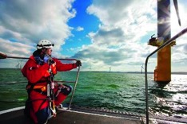
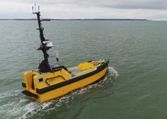
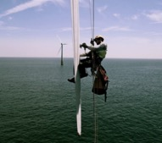
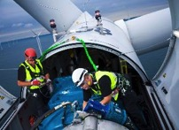
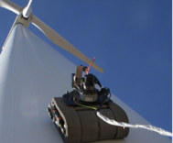
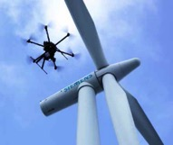
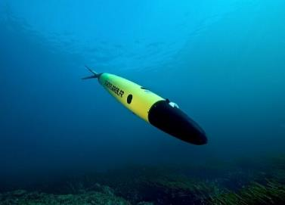
Applications to O&M
Manual
Today
Autonomous
Tomorrow

Slide 6
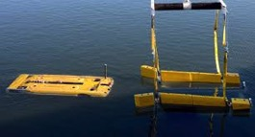
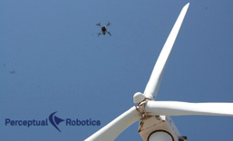
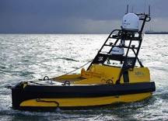
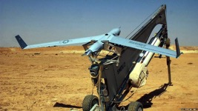
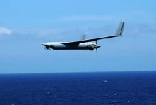
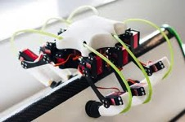
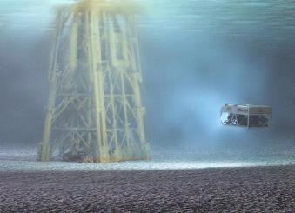
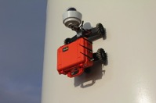
Our current projects
AVISIoN
Autonomous Wind Farm Inspection
LEADWind
Bladebug
ROVCO 3D
iFROG
WASP

Slide 7
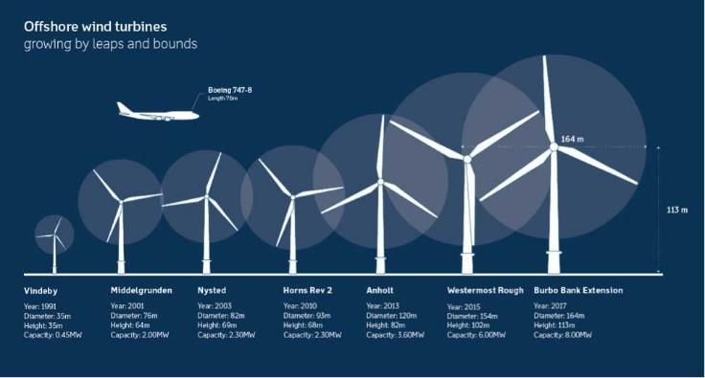
Offshore turbines: past, present, and future
Offshore wind turbines are getting larger
Financial implications are larger for downtime
Risk appetite will continue to decrease
Reliable and robust inspection and maintenance will be key
Industry engagement has revealed a need to ensure Inspection Technology and Services are and will continue to be reliable and robust method of inspection
UAV Inspection Quality Guidance → Standards Development
Next generation
Year 2020 - 2030
Height 120m
Capacity 10 - 14MW
Notes:
Headlines:
Offshore wind turbines continue to increase in size
This trend looks likely to continue

Slide 8
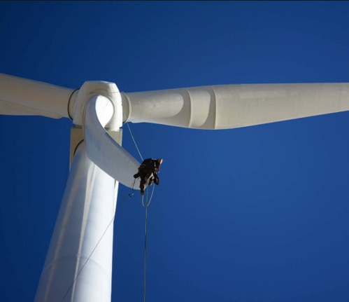
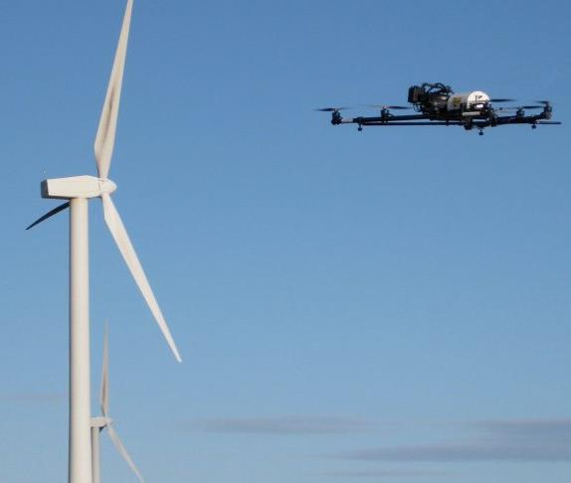
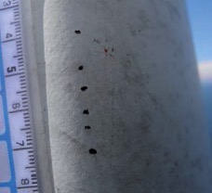
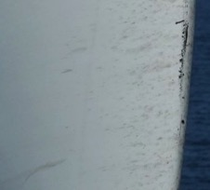
Innovation
Conventional Blade Inspection
UAV Blade Inspection

Slide 9
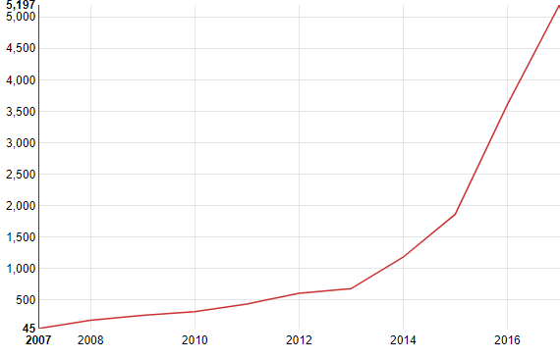
Innovation
UAV technology is growing exponentially
Decreasing cost of component technologies
Boom in Industrial and Consumer UAV market
Offshore wind industry already embracing UAV Technology
why are we talking about developing industry guidance and standards??...
*Data from https://www.lens.org/ searching for ‘UAV’ in descriptions
Number of ‘UAV’ patents filed 2007-2017

Slide 10
Industry Feedback
Customer
Risk averse
Limited expertise in UAV operations
Focus on O&M cost and safety
Variance in inspection quality
Negative experiences with ‘cowboy’ suppliers
Owner Operators, Operations and Maintenance Contractors

Slide 11
Industry Feedback
Supply Chain / Innovators
Differing requirements across industry
Subjective requirements
Limited feedback
Proving capabilities
Getting ‘foot in the door’… ‘Chicken or Egg?’
Measurable customer requirements
UAV Inspection, Technology Innovators, Academia

Slide 12
Why does industry need Guidance / Standard?
Customer
De-risks the supply chain
Improves quality
Increases consistency of services
Guidance/ Standard
Customer
Supply Chain
Innovators
Supply chain
Single set of agreed requirements
Enables services to be optimised
Framework for validating services
Innovators
Requirements available for targeted innovation
Framework for validating technology
Guidance / Standard for UAV inspection to assist industry

Slide 13
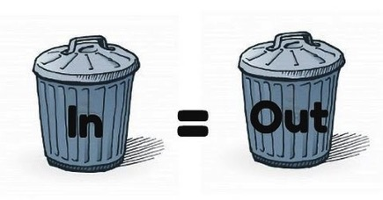
What should the standard consider?
Requirements
Planning
Inspection
Analysis
Reporting
Data Acquired
How do we assess inspection data quality??
Ensure inspections meet customer needs
Quality validation of ‘Data In’ to ensure ‘Data Out’ meets customer needs
Not to specify how to plan / inspect / technology to use etc. as these are up to innovators and supply chain
Data quality

Slide 14
Defining Quality
Inspection Quality
Image Quality
Metadata Quality
Practicalities and Performance
Image Quality Metrics
Metadata Metrics
Performance Metrics
Resolution, Contrast, Exposure, Sharpness…
Location & Size Accuracy…
Reliability, Speed, Operating conditions
Subjective?
Measurable
Measurable

Slide 15
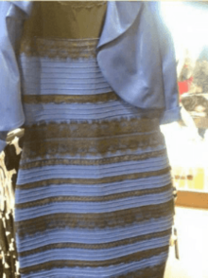
What do you see?
Black and Blue?
White and Gold?
What colour is the dress?

Slide 16
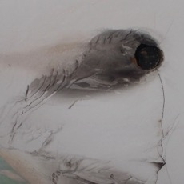
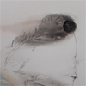
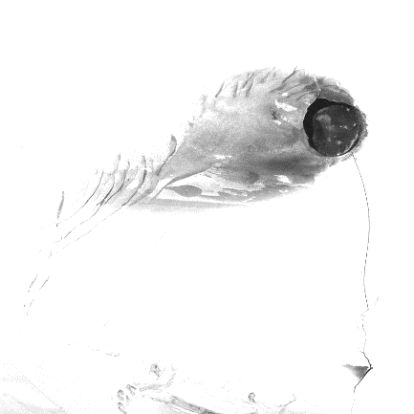
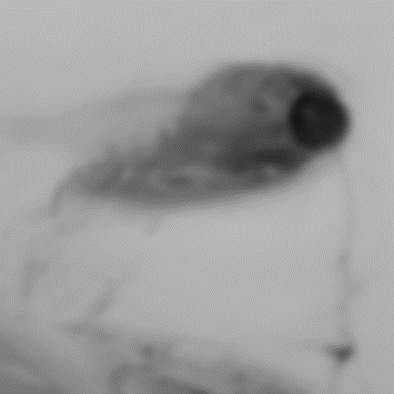
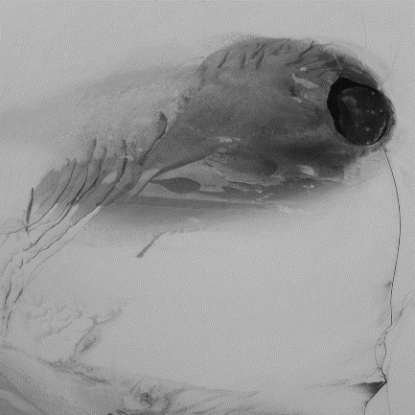
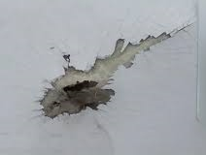
Image quality can be subjective
✓
✗
✗
✗
✗
Focus?
Sharpness?
Contrast?
Brightness?
Exposure?
Dynamic Range?
Tone?
Artefacts?
?

Slide 17
How can we validate inspection quality using measurable parameters and decrease the subjective nature of perception?

Slide 18
Image Quality Assessment (IQA)
IQA measures perceived image quality
Improves subjectivity of assessment
Typically used for evaluation of imaging systems and software
Complex subject matter with many existing studies
No need to reinvent the wheel
Sharpness
Noise
Dynamic Range
Tone
Contrast
Colour
Distortion
Vignette
Exposure
Chromatic Aberration
Lens Flare
Artefacts
IQA principles can be applied to validating visual inspection data
IQA Parameters

Slide 19
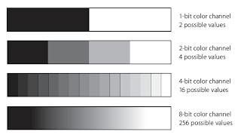
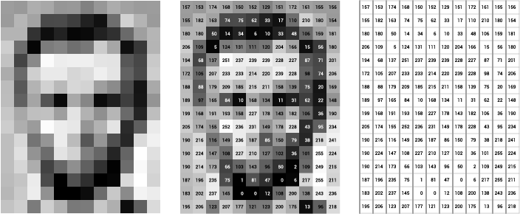
Image Quality
Digital images fundamentally consist of a series of numbers
Considering a 8 bit greyscale digital image:
Each pixel is represented by a single byte of data (8 bits)
Each can be 0-255 in value (8 bits = 256 values)
The pixel byte represents ‘brightness’ of the pixel
Therefore the image consists of a large numerical matrix
Images are numerical
Calculations and statistics can be used → Digital IQA methods
Digital Images

Slide 20
Image Quality - Sharpness / Focus
“Actuance”
Perceived sharpness or edge contrast of an image
Gradient calculations can be made across an image matrix:

Slide 21
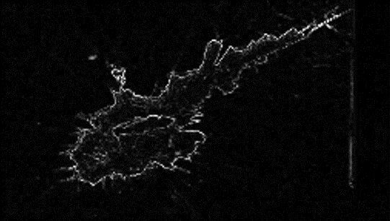
Image Quality - Sharpness / Focus
“Actuance”
Perceived sharpness or edge contrast of an image
Gradient calculations can be made across an image matrix:
Actuance = Mean of the Gradient calculation
Higher value shows higher perceived sharpness
Numerical value must be calibrated to what is perceived as ‘sharp’
Subjective Quality Factor
Sharpness of an image is a combination of Actuance and Resolution
Actuance values must be normalised
10.04
6.98

Slide 22
Image Quality - Dynamic Range / Exposure
Histograms
Can be produced from the image numerical data
Showing statistical trends about the light data in the image

Slide 23
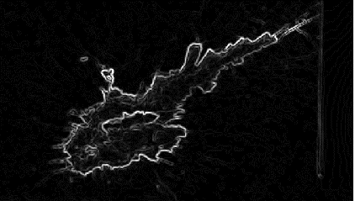
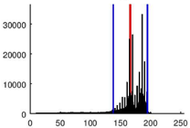
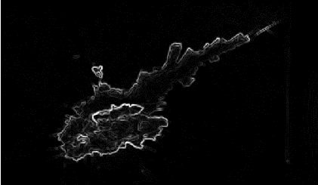
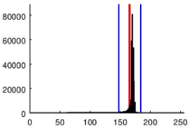
Image Quality - Dynamic Range / Exposure
Histograms
Can be produced from the image numerical data
Showing statistical trends about the light data in the image
Dynamic Range
Is the range (ratio) of high vs. low values
Wider range can indicate greater level of detail
Can be calculated using numerical methods such as SD
SD = 28.3
SD = 18.2

Slide 24
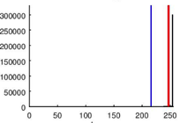
Image Quality - Dynamic Range / Exposure
Histograms
Can be produced from the image numerical data
Showing statistical trends about the light data in the image
Dynamic Range
Is the range (ratio) of high vs. low values
Wider range can indicate greater level of detail
Can be calculated using numerical methods such as SD
Exposure
Over/Under exposure results in light information being lost
Occurs when light levels are above/below sensor capability
Can be calculated using numerical methods such as Mean
SD = 18.2

Slide 25
Using mathematics and statistics we can in fact derive quantitative quality metrics for digital images

Slide 26
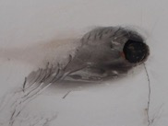
Metadata
Which turbine? Which blade? Where? How large?
High quality defect imaging itself is useless without metadata
Required metadata includes:
?
?
?
Turbine / Blade
Time and date
Location on the blade (which side)
Position on the blade (span)
Size (diameter or width x height)
Orientation
?
?
These parameters are numerical already and quality can be quantitatively evaluated
Metadata Required

Slide 27
Quality isn’t everything… We need context
Practicalities
Site constraints
Time / Crew / Resources…
Environmental conditions
Image Quality
Quality
Piloting / Automation
Metadata
Detection Rate / Reliability

Slide 28
Practicalities and Performance
Outstanding quality can be achieved if cost and time are infinite
Therefore practicalities (time & cost) must be accounted for
Some key factors include:
Development of reference data should keep key parameters constant or recorded
Speed of inspection
Reliability of detection (repeatability)
Operating location (vessel vs. platform)
Weather conditions (wind, light, visibility…)
Number of people in flight crew
Required turbine control / intervention
Additional required operations
Time, Cost, Quality Trade Off

Slide 29
Developing Guidance
Customer Requirements Capture
Validate against requirements
Controlled UAV trials at test turbine
Evaluation of Test Results
Verification
Validation
Does solution meet customer needs?
Quality metrics definition
UAV and services testing and demo
What are the primary requirements?
Identify baseline and minimum requirements
Generate Guidance → Standard
UAV Blade Inspection V&V Process

Slide 30
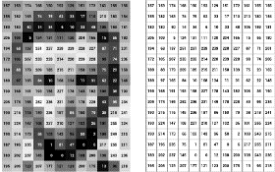
Developing Guidance - Metrics
Data from trials will be used to generate quality metrics
Customer Requirements Capture
Validate against requirements
Controlled UAV trials at test turbine
Evaluation of Test Results
Verification
Validation
Does solution meet customer needs?
Quality metrics definition
UAV and services testing and demo
What are the primary requirements?
42
Identify baseline and minimum requirements
Generate Guidance → Standard
UAV Blade Inspection V&V Process

Slide 31
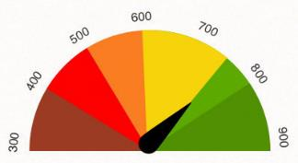
Developing Guidance - Baseline
Calibration of acceptable quality metrics using anonymised data
Customer Requirements Capture
Validate against requirements
42
Controlled UAV trials at test turbine
Evaluation of Test Results
Verification
Validation
Does solution meet customer needs?
Quality metrics definition
UAV and services testing and demo
What are the primary requirements?
Use baseline requirements to build guidance and standard
Identify baseline and minimum requirements
Generate Guidance → Standard
UAV Blade Inspection V&V Process

Slide 32
Developing Guidance - Baseline
}
Customer Requirements Capture
Validate against requirements
Test UAV Inspection data using developed method to validate that customer requirements are met
Controlled UAV trials at test turbine
Evaluation of Test Results
Verification
Validation
Does solution meet customer needs?
Quality metrics definition
UAV and services testing and demo
What are the primary requirements?
Identify baseline and minimum requirements
Generate Guidance → Standard
UAV Blade Inspection V&V Process

Slide 33
Developing Guidance - Timescales
Started 2017 → Ongoing
Customer Requirements Capture
Validate against requirements
Controlled UAV trials at test turbine
Evaluation of Test Results
Aug 2018
Verification
Validation
Q1+ 2019
Does solution meet customer needs?
Quality metrics definition
UAV and services testing and demo
What are the primary requirements?
Q4 2018
Identify baseline and minimum requirements
Generate Guidance → Standard
Q4 2018
UAV Blade Inspection V&V Process

Slide 34
Why ORE Catapult?
Relationships with industry, service providers and innovators
Independent and impartial organisation
trusted with handling sensitive data
Owner and operator of world leading test, demo and validation assets
Experienced in development of test and validation processes
Expert team in forming and running industry projects and collaborations
“ work in close partnership with the offshore renewables industry to improve existing and develop next generation renewable energy technology in the UK ”
ORE Catapult Strategy

Slide 35
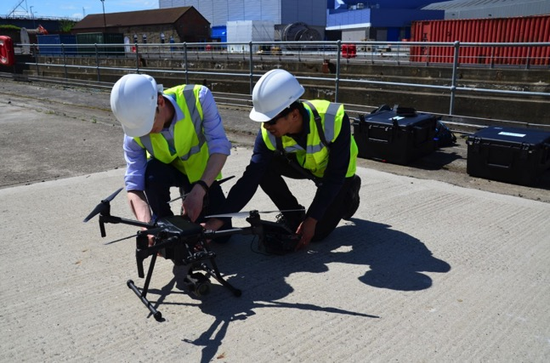
Thank you for listening!
Tony.Fong@ore.catapult.org.uk

